Slide 1
Test Flow

Slide 2
Patient listing and registration
This section allows for patient registration in the case of referred patients or those not registered in the hospital EMR system. A listing of all the patients available is shown as captured below.

Slide 3
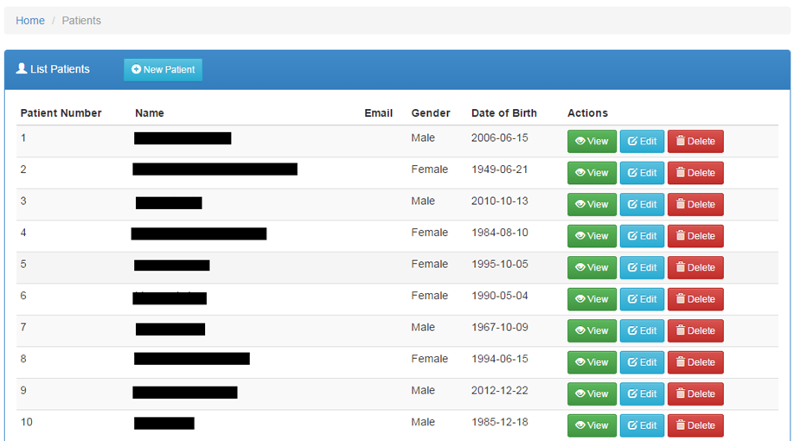
Listing patients
From the homepage, click the patients tab on the navigation menu for the patients list portlet to be shown

Slide 4

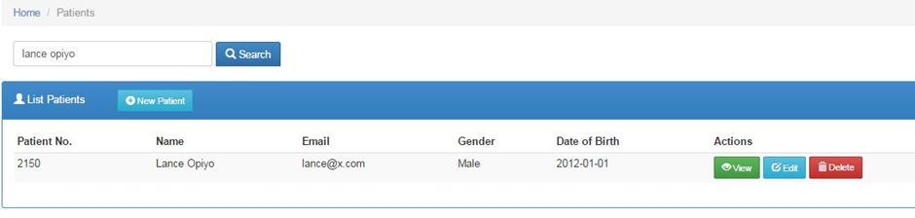
Searching for a patient
1. Begin typing the patient name on the search field
2. The patient details searched will be loaded with matching values e.g.

Slide 5


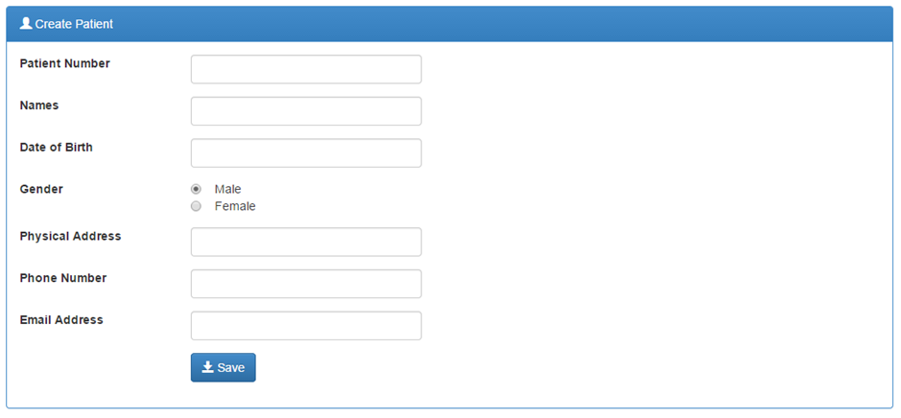
Patient Registration
To register a patient, click on the button at the top of the blue portlet.
After completing the form, click the button at the bottom of the form. Using the Save button will instantly save the details to the system.

Slide 6

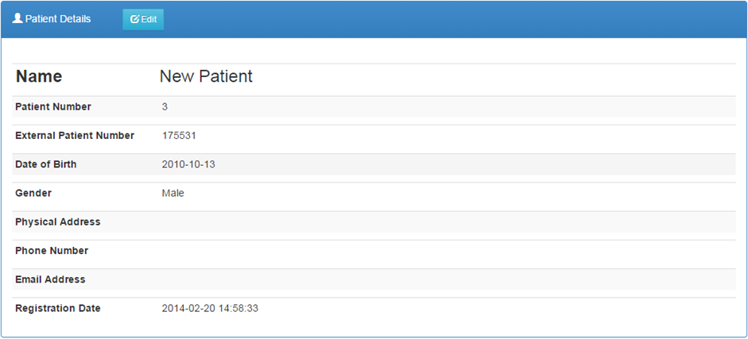
Viewing a patient’s details
1. Click the button on the Actions column with the corresponding row of the patient listed to see the details as shown below.

Slide 7

Continuation…
2. To get back to the patients list, click on Patients hyperlink on the breadcrumb.

Slide 8

Editing a patient’s details
1. On the patients list, click on the button
2. After making your modifications, click the button to push the changes to the system
3. An alternative way to edit patient details is to use the button on the patients list then click
on the button once the details have been displayed.

Slide 9
Laboratory tests
Different medical systems have distinct stages and processes of conducting medical test. This document will track the life cycle of a medical test on-board iBLIS.
After receiving test request from a patient or other embedded systems the immediate step is to book for the test via the laboratory system. The initial stage of capturing the test details is most important stage. In essence, accurate data capturing will streamline the logical steps to ensure that what you test is what you meant to test, and that the final test report meets the client’s needs and expectations.

Slide 10

Listing ordered tests
Click the tab on the navigation menu to load a list of all ordered tests.

Slide 11
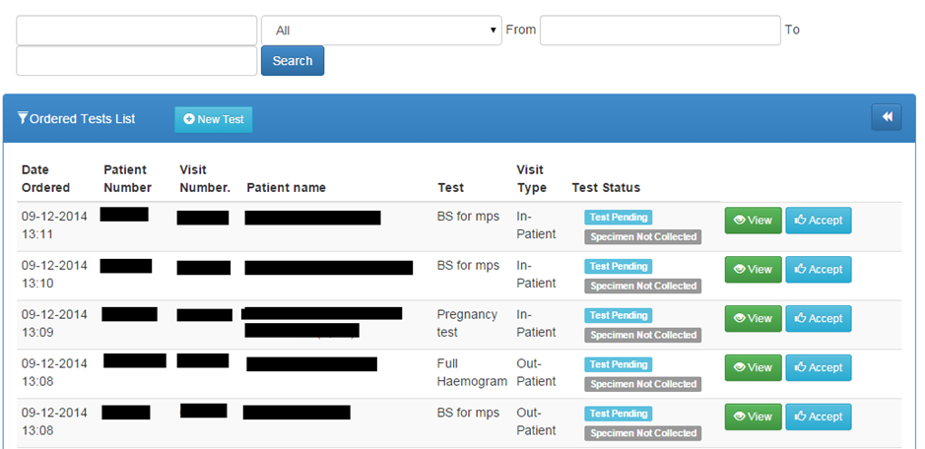
Searching for a lab request
Below is the first interface during the testing process. Once you have your search parameters in place, click the search button.

Slide 12
Booking a test
For referrals to the lab and tests that do not originate from the hospital EMR system, lab requests have to be created at the lab.
The iBLIS system can accept and initiate test requests through different approaches discussed below.

Slide 13

i) By use of the Tests Link
1. Click the button to launch the test order form.
2. Select the desired patient by tying the patient Id or Name or by clicking the GO button to list the available patients.

Slide 14
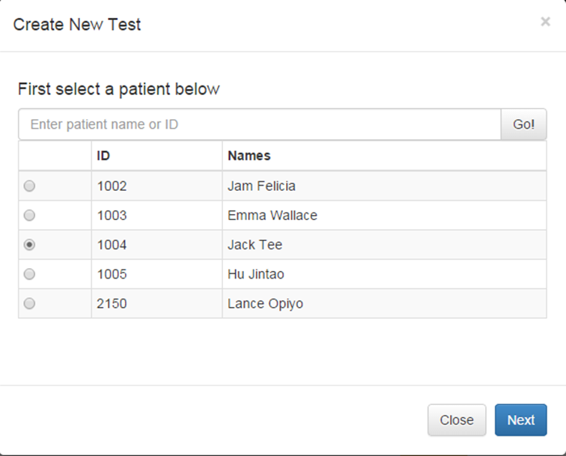
Continuation….

Slide 15

Continuation….
3. Click the button to launch the new test order form.
4. In the New test page, input the visit type, the requesting physician and from the listed tests, select the desired test(s).

Slide 16
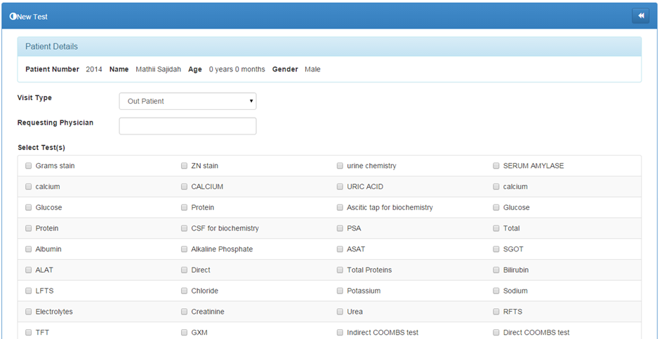

Continuation….
5. Click the button to save the details.

Slide 17

ii). By use of the patient's details page
A test can be booked directly from the patient details page. This page can be accessed after selecting the patient at subject of the tests.
1. Click on the link on the side bar navigation menu on the left of the screen.
2. Identify the desired patient and click the corresponding
button to load the Patient Details page.

Slide 18
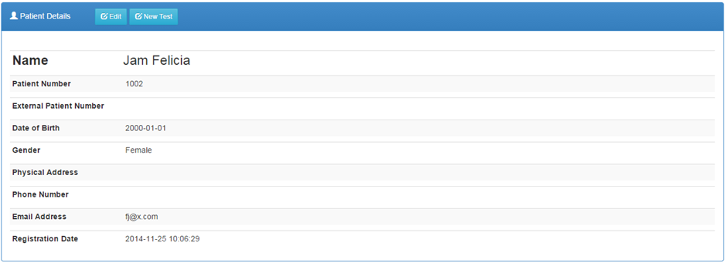
Continuation….
Click the button

Slide 19
iii). By use of an external system
BLIS will have a module through which a test order can be invoked by multiple external systems. This will only happen if the systems can integrate and map fully with BLIS.
External system configuration and integration with BLIS will depend on the available systems in any given hospital.
All the embedded systems will fully be tested to ensure a smooth running of BLIS and the particular system at stake before inter-dependability can be authorized.

Slide 20

Viewing a lab test request
1. On the ordered list of tests, click on the button on the corresponding row of the request.
2. To get back to the test list, click the icon on the top right corner of the ‘Test Details’ portlet.

Slide 21
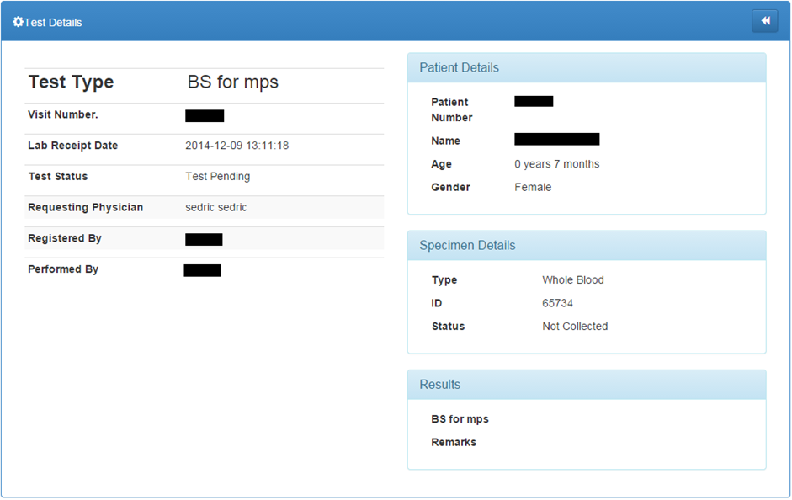
Continuation….

Slide 22


Accepting a specimen
Before the testing process is started the acceptance of the specimen must be registered in the iBLIS system. This will be achieved through;
1. Click on the link on the side bar navigation menu on the left of the screen.
2. Select the test of interest and check where Test Status is
3. Click on the button to acknowledge the specimen.
4. This will change the specimen status to and the button to the test will show, plus a button in case the specimen is deemed unsuitable.

Slide 23
Rejecting a specimen
Specimen can be rejected on several levels in iBLIS.
The first level is during specimen collection. Mistakes can be made hence making the specimen unsuitable.
On other occasions the specimen samples can be damaged or contaminated during testing.
If the collected specimen cannot progress to testing and actualize the test due to various reasons it can then be rejected through;

Slide 24


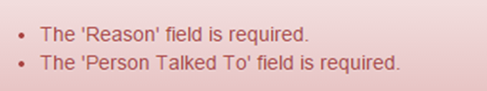
Continuation….
1. Click on the link on the side bar navigation menu on the left of the screen.
2. Select the test of interest and check where Test Status is
3. Click on the button to reject the specimen.
4. Fill in the form appropriately then click the button at the bottom to complete the rejection.
5. You will be notified of any errors during rejection like

Slide 25
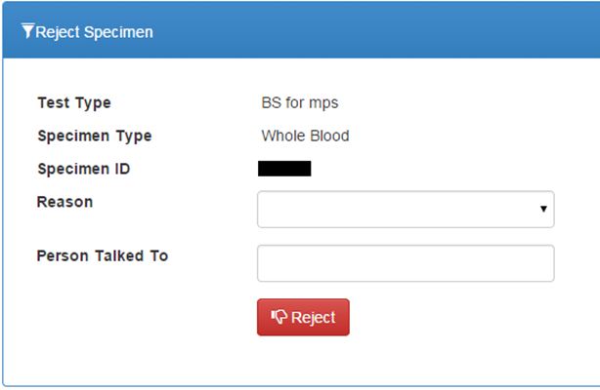
Continuation….

Slide 26


Referring a Test
The accepted specimen can be referred via;
1. Click on the link on the side bar navigation menu on the left of the screen.
2. Select the test of interest and check where Test Status is and
3. Click on the button.
Fill in the form
5. Click the button
NB: The process is similar for both referred-in tests and those referred out. You just have to indicate whether it is a refer In or out

Slide 27
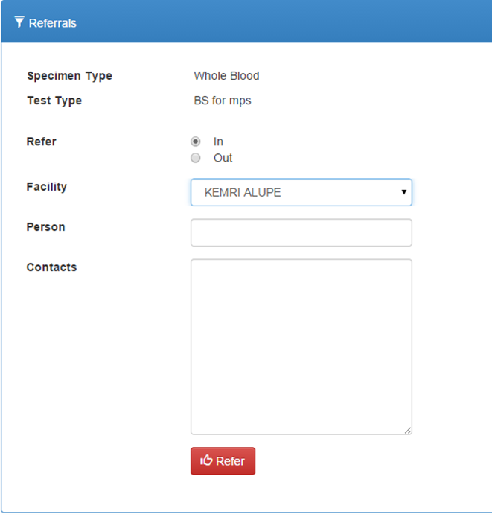
Continuation…..

Slide 28



Starting a Test
A test can only be started if the collected specimen is suitable
1. Click on the link.
2. Select the test of interest and check where Test Status is and
3. Click on the button to commence the testing process. The test status changes to

Slide 29


Entering the results
After a successful test, the results are then recorded into iBLIS. The page can be accessed via;
1. Click on the link.
2. Select the test that whose results are ready.
3. Click on the button to feed the results into the system
4. Fill the results form
5. Click the button to save the results to the system

Slide 30

Full Haemogram results on Celltac F machine
1. Click the button on the corresponding test on the list of tests.
2. On the Celltac F machine; press Print Results button to send the results from the Celltac F machine to the computer.
3. Click the button on the results panel to autofill the form with the test results as shown below.
4. Click the button to save the results to the system.

Slide 31


Editing Test Results
If the test results were entered incorrectly they can be edited. This can only be done before test verification following the steps below;
1. Click on the link.
2. Select the test whose results are to be edited and test status is
3. Click on the button to make the changes.
Make the necessary modifications on the form presented.
Click the button to save the changes.

Slide 32


Verifying Test Results
A test can only be verified if all the above processes and conditions are correctly actualized.
The results will be compared against preset criteria designed for verifying the particular test;
1. Click on the link.
2. Select the test whose results are to be verified and test status is .
3. Click on the button to proceed to the test details page.
4. Click on the button on the test details page to commit the verifications.

Slide 33
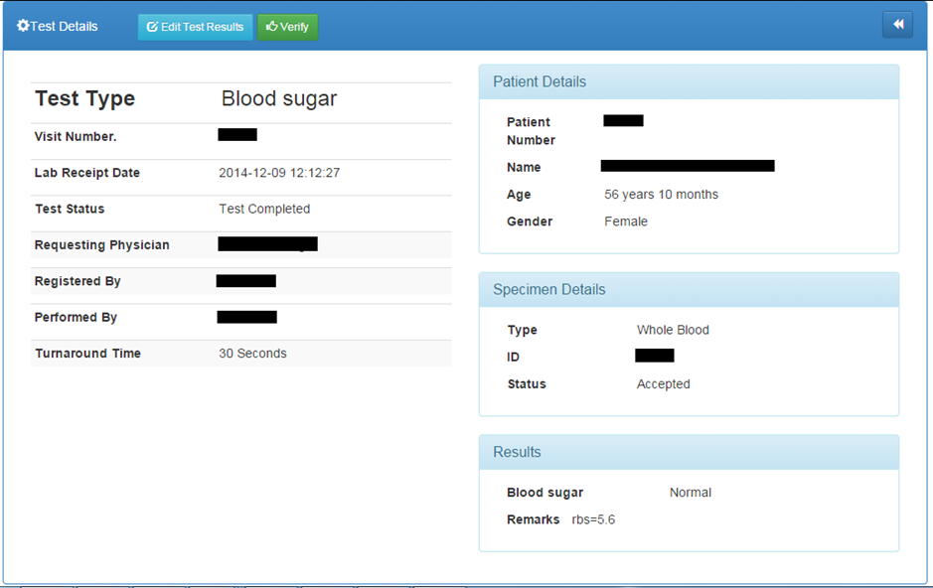
Continuation….

